Slide 1



NBA – Fan Engagement Analysis
Sree Duddupudi
[MBAN 2]

Slide 2

CASE AGENDA
Business Goal
Understanding the case,
Analyzing Nike’s market performance,
Competitor analysis
Data Processing
Data pre- processing,
Key-Takeaways
Findings,
Text frequency and association analysis,
Sentiment Analysis
Opportunities,
Recommendations

Slide 3
NIKE- A BRIEF OVERVIEW 2020
Nike is an American MNC, that is engaged in the design, development, manufacturing, and worldwide marketing and sales of footwear, apparel, equipment, accessories, and services.
It is the world's largest supplier of athletic shoes and a major manufacturer of sports equipment, with revenue in excess of US$37.4 billion in its fiscal year 2020 (ending May 31, 2020).[
In 2020,
$37.4 billion – Brand value
70.67%- Free cash flow
4.38% - Decline in revenue
22% - Decline in EBITDA

Slide 4
THE BUSINESS CHALLENGE
To perform a qualitative analysis by using different ways to explore the NBA Fans engagement on TWITTER during 2019-2020, the 74th NBA season.
Understand the change in sentiments of the fans during the entire season and propose insights that can help Nike’s marketing team to enhance their current performance.
Analyze the competitors like Adidas, Under Armour, etc.

Slide 5
APPROACH TO THE CASE: NBA 2019-20 TIMELINE
MONTH | NBA STATUS
October 2019 | New NBA season starts
February 2020 | NBA ”All Star Game” - Won by Team LeBron!
March 2020 | Suspended due to COVID.
30 July 2020 | Restart of the season. - 22 teams played out of which 16 entered the league.
August 2020 | Suspended again due to wild cat strike. Protest the crimes against black people. League Restarted
October 2020 | League Ended.
“LONGEST SEASON IN THE HISTORY OF NBA"

Slide 6
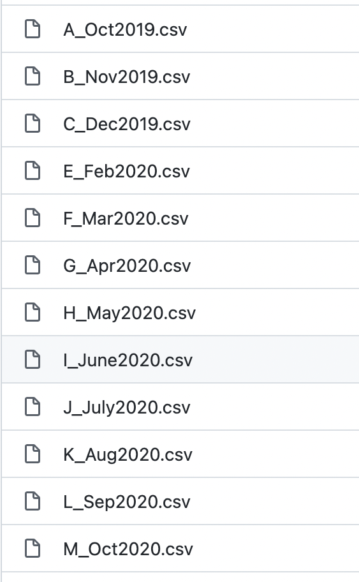
INTRODUCTION TO THE DATASET
Excluded from the analysis
Oct, Nov, Dec 2019 – Season beginning, Halloween, Black Friday, Christmas, New Years.
Feb 2020 – All stars NBA match
Aug, Sep, Oct 2020 – Season end
Final data set.
Randomly pick 10000 rows from each month and compile them into one large data frame for quicker analysis.

Slide 7
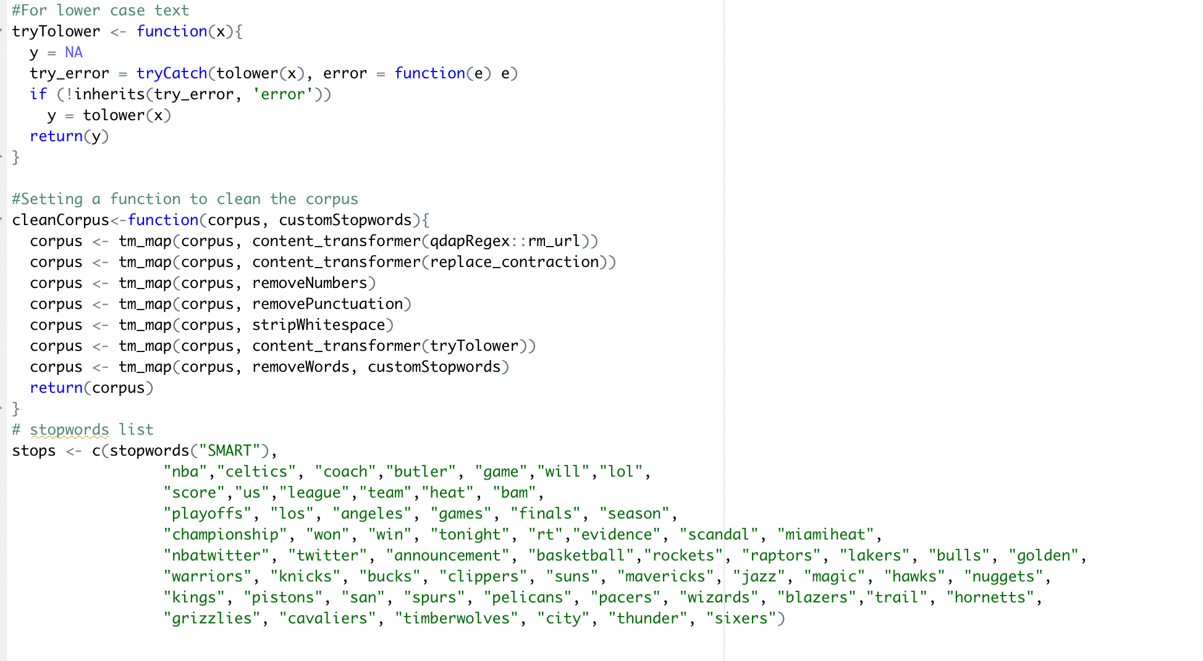
DATA CLEANING
Created universal functions to format
the font and to clean the texts.
Customized the stop words list so that
Words which do not impact our analysis
could be removed. All the second names
Of the teams are removed to avoid
Repetition of the same team in word
Clouds. Ex: “LA LAKERS”.

Slide 8
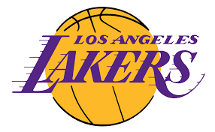


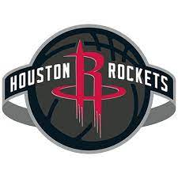
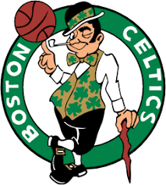
TOP 5: MOST TWEETED TEAMS
3449 tweets
1870 tweets
2778 tweets
1916 tweets
2008 tweets

Slide 9
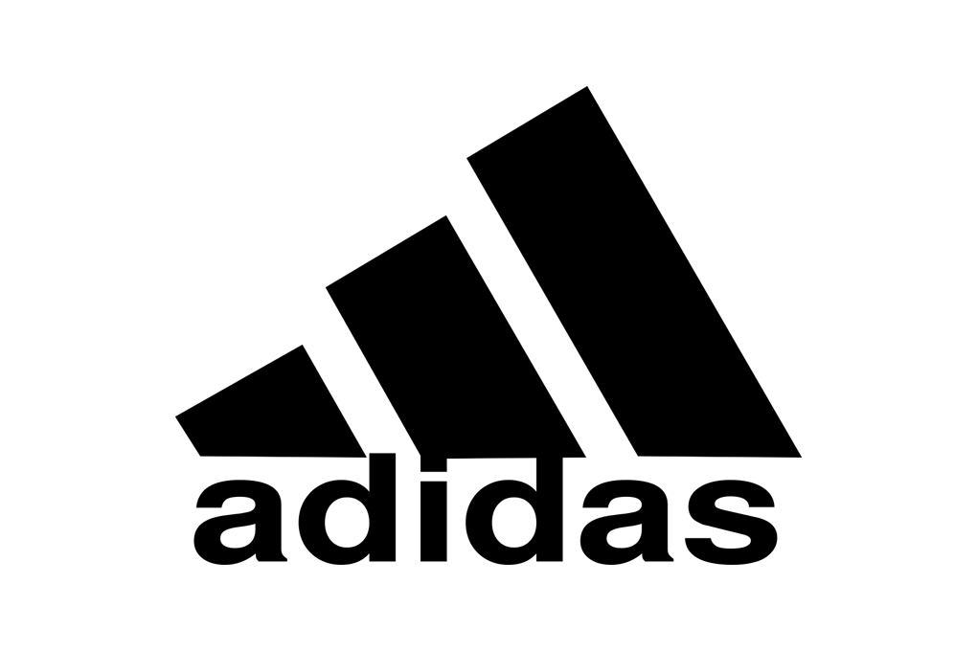
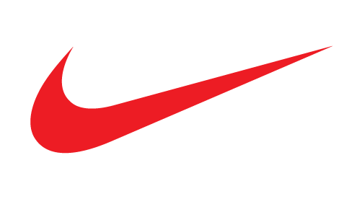
COMPETITOR ANALYSIS
Pulled the Nike-specific tweets and the Adidas-specific tweets in separate data frames.
Conducted word associations and sentiment analysis of the brands with respect to the overall data set.

Slide 10

WORD ASSOCIATIONS

Slide 11
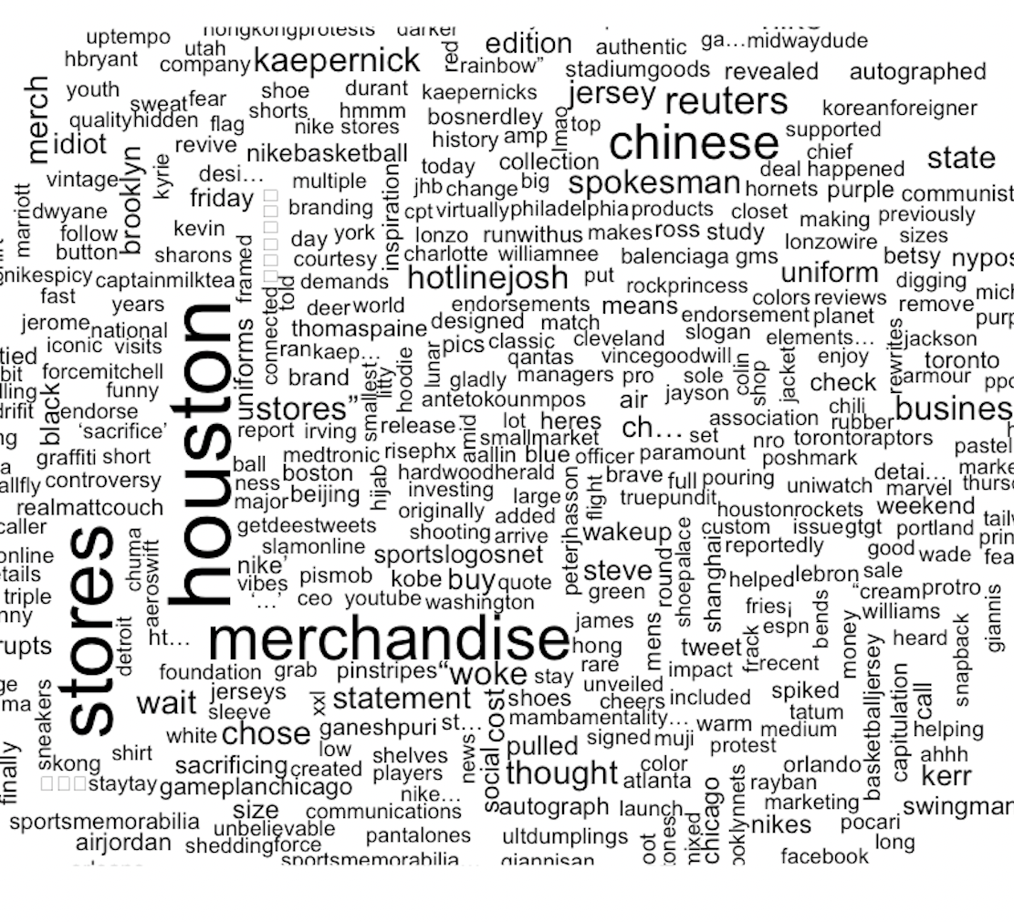
NIKE WORDCLOUD
Lots of mentions about the Nike merchandise and Stores.
Surge in the popularity of Houston Rockets – 4th place in the Western conference.
Josh Kraushaar “hotlinejosh”, Kaepernick, Thomas Paine and other American activists and political terms like spokesperson, assembly, protest, capitulation, communist, etc.
Kobe, James, Durant, etc. are mentioned

Slide 12
SALES INSIGHT
MENS
HOODIES
STADIUMGOODS
JERSEYS
SHIRTS
NIKE
SNEAKERS
AIR JORDAN

Slide 13
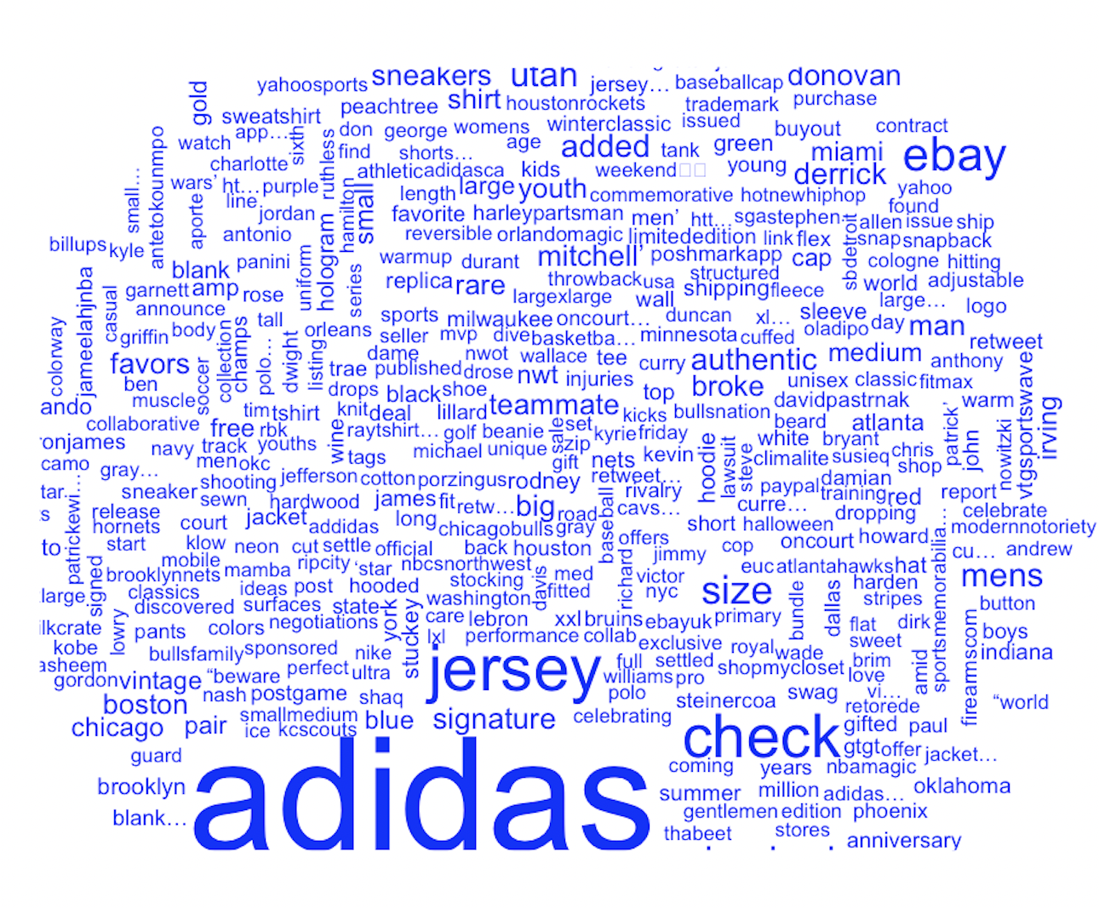
ADIDAS WORDCLOUD
Jerseys, Men’s, eBay, Poshmarkapp, deals
James Harden, Mitchell, ringknowsring, etc.

Slide 14
General insight
Had lesser political and rarely any negative words in the cloud.
Lots of terms like ‘youth’, ‘kids’, ‘size’, ‘broke’ can be used to estimate that the audience could be of younger age ranges in comparison.

Slide 15

SENTIMENT ANALYSIS

Slide 16
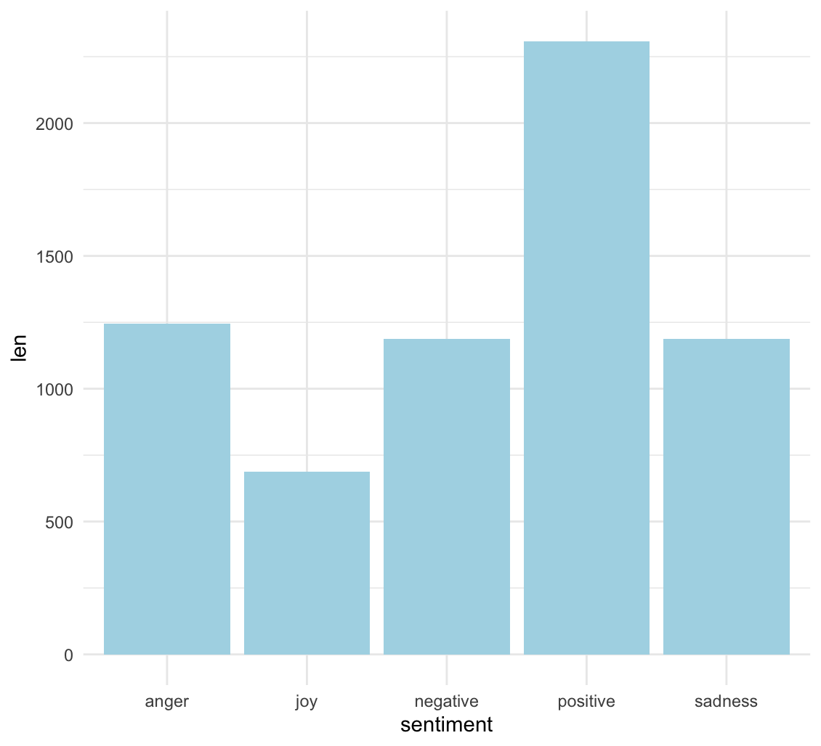
OVERALL SENTIMENT ANALYSIS

Slide 17
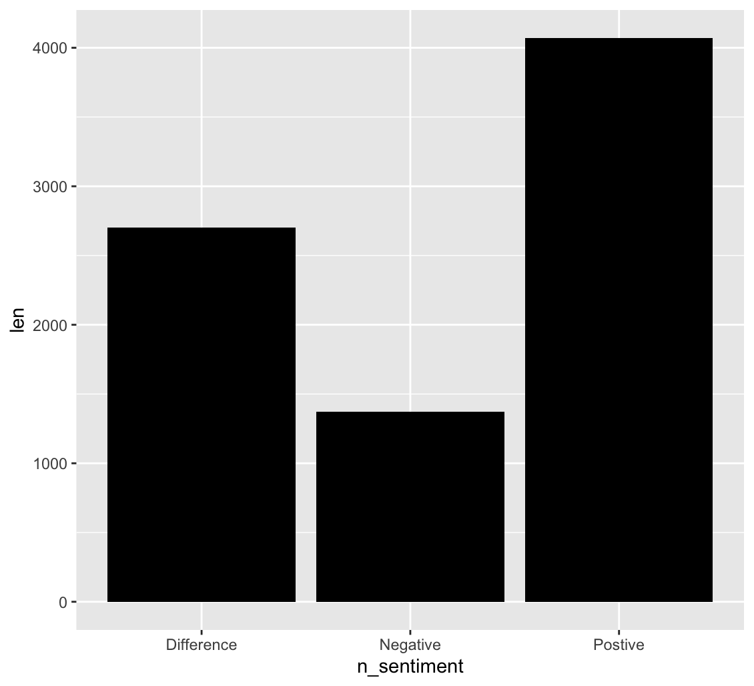
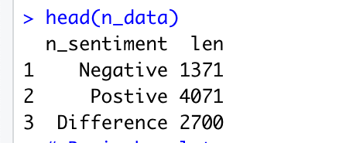
NIKE SENTIMENT ANALYSIS

Slide 18
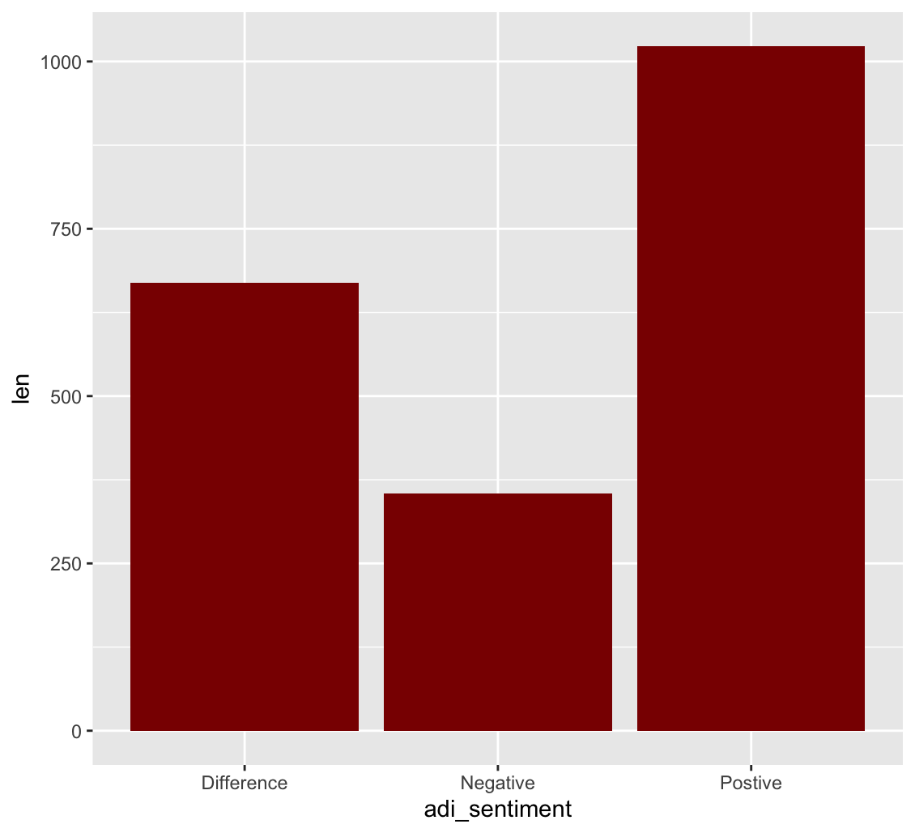
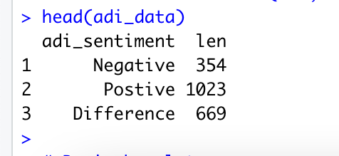
ADIDAS SENTIMENT ANALYSIS

Slide 19

COMPARISON?

Slide 20
AREAS TO CONSIDER
Lots of tweets from American activists and journalists. Could this be because of the wild cat strike when the players protested crimes against Black people? Nike can create new awareness campaigns and make online content with famous NBA Players as the front.
Lots of political and negative terms in the cloud, how can this be leveraged positively for our stakeholders? The negative words in the could be of use to detect the common users’ requirements from Nike!
Why are the customized goods like JORDANS, players’ lines of sneakers not seen anywhere in the cloud? Even during the holiday season? Does this mean our audience are not up for the prices?
There are a lot of mentions regarding ‘STORES’ but what is the sales scenario in the e-comm segment? No mention of Amazon/eBay? Do the audience prefer stores more than online platforms?

Slide 21
RECOMMENDATIONS
INCREASE ONLINE PRESENCE
PRODUCT INNOVATION
MARKETING TECHNOLOGY INNOVATION
Invest in e-sports to increase the Brand’s presence in multiple sports platforms.
Online promotions in NBA Team websites and fan engagement websites.
Use AI to develop ways to identify counterfeit and fake merchandise sales to improve online purchase behavior.
Employ machine learning and AI for customer-centric marketing.
Create more NBA-inspired promotions.
Increase apparel goods
Revisit pricing strategies for sneakers and jerseys

Slide 22

THANK YOU!
Github: https://github.com/slsworks

